Slide 1
Automated Deployment of Cloud Resources GIG – Managed hosting Infrastructure (MHI)
By: Ngiam Yee Tong

Slide 2
Table of Contents
Background
Requirements
Architecture
Components
Automation

Slide 3

Background
Organization is undergoing a transformation to leverage on Cloud Technology by migrating on-premises workload to the AWS Commercial Cloud. The engineers are required to migrate a simple Web application running on Windows Server 2019 to AWS Cloud. In order to facilitate the migration of similar setups, there is a need to work on an automated solution to assist the engineers to come up with a template for provisioning of a simple Web application in AWS Commercial Cloud. (From GovTech)
Assumption: Simple web server with a database(DB) server
~ Web Server using Microsoft IIS
~ DB Server using SQL database

Slide 4
Requirements
Simple web application using Amazon Web Services (AWS).
Ensure high availability across multiple availability zones in the Singapore region.
Use AWS Elastic Load Balancer (ELB) to distribute traffic across instances.
Automate infrastructure provisioning
Design should be based on security best practices.

Slide 5
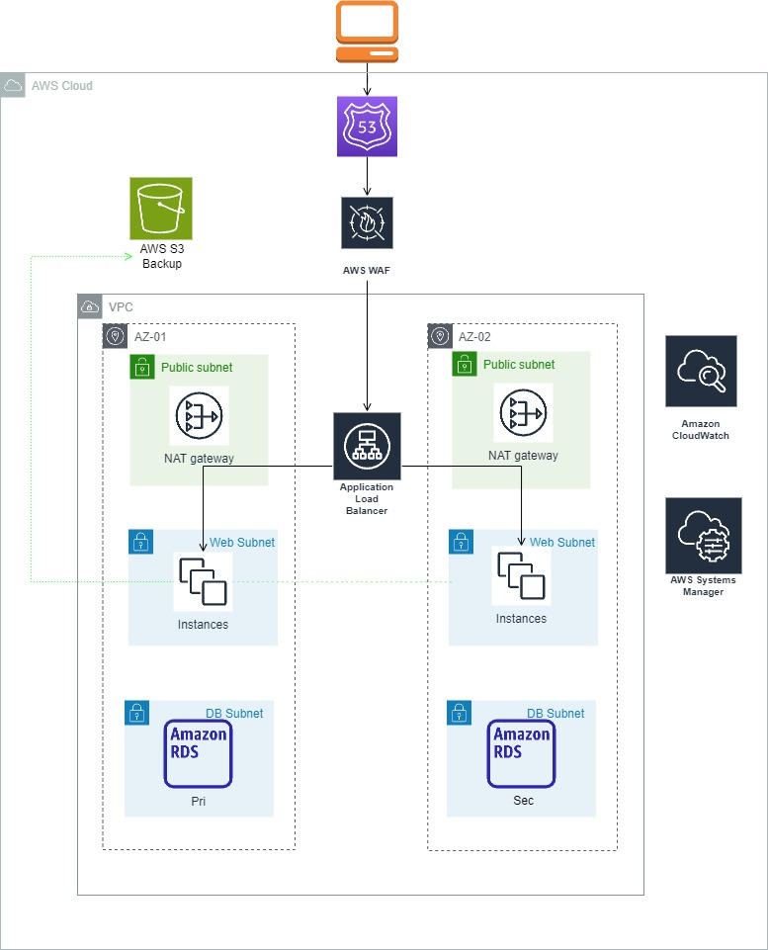
Architecture

Slide 6

Main Components
EC2 Instances
Different zones
OS : Windows Server 2019
Virtual Private Cloud
Public Subnet and Private Subnets in 2 Availability Zones
Use security groups to control traffic and security
Application Load Balancer
To distribute incoming traffic to EC2 instances span across availability zones
AWS Route 53
DNS service to route traffic based on requested path for static and dynamic content

Slide 7

Security Components
IAM
Assign proper IAM roles for services
AWS Web Application Firewall
To protect against common web application attack
AWS CloudWatch
To monitor web server in real time, with logs, data and metrics
AWS Systems Patch Manager
To automate process of security patching instances (For future scaling)

Slide 8
Automation
AWS Cloud Formation (CF)
– To automate set up of resources – CF Stack
– CF template can be easily replicate, delete and modified
– Since templates are just text files, infrastructure can be control and track easily

Slide 9

The End
Reference:
https://aws.amazon.com/architecture
Thank you for reaching here!
To know me more:
https://www.linkedin.com/in/yeetongngiam/

